Slide 1
Large Language Models
Introduction to Generative AI.pptx

Slide 2
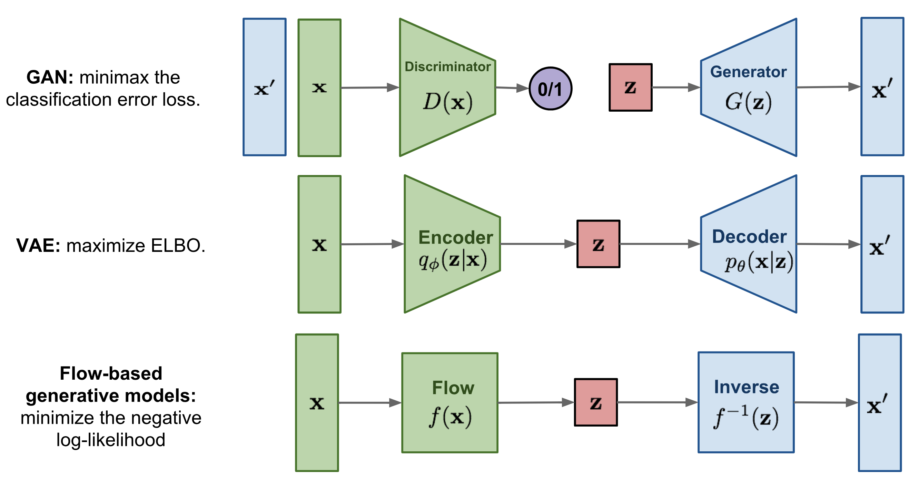
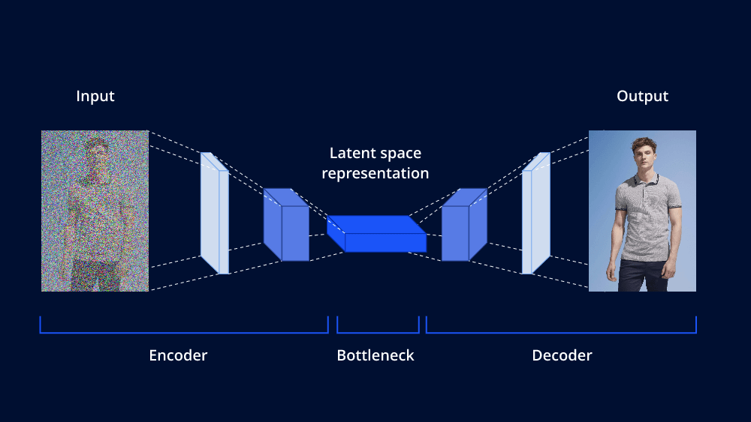
What is Generative AI?
Generative AI focuses on algorithms creating new content (text, images, audio, video). Unlike discriminative models that classify data, generative models learn the data's underlying distribution to produce novel outputs. Key characteristics include diverse outputs, some generation control, and learning complex data patterns.

Slide 3
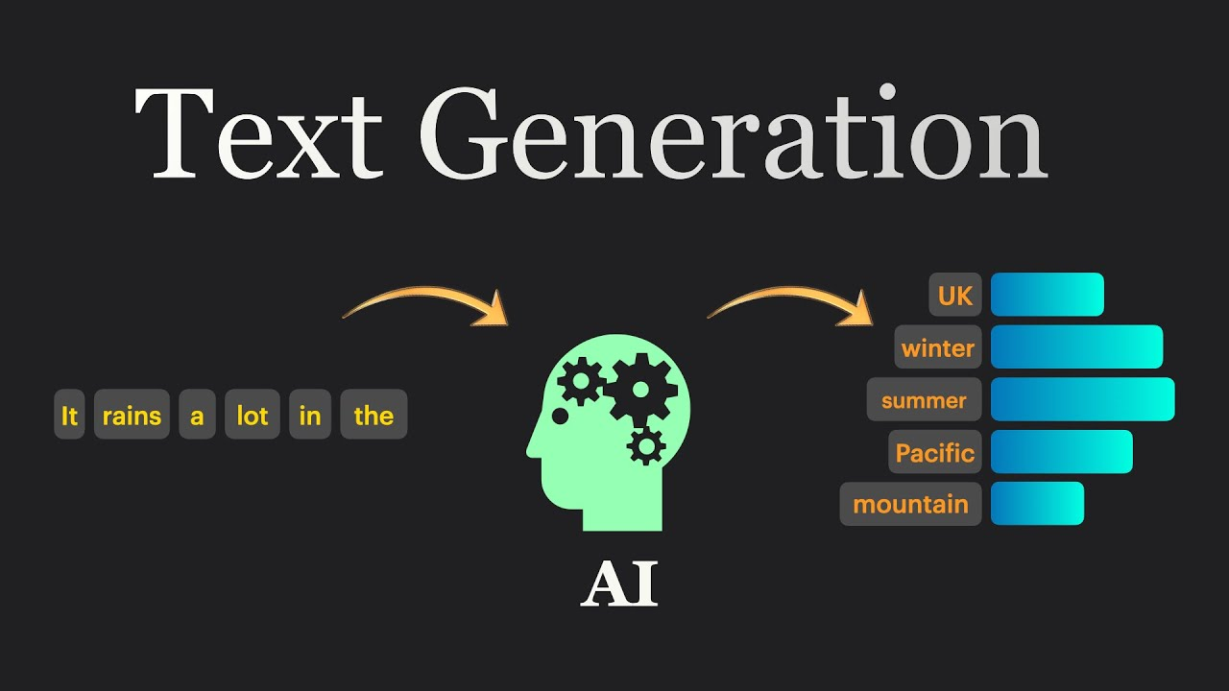
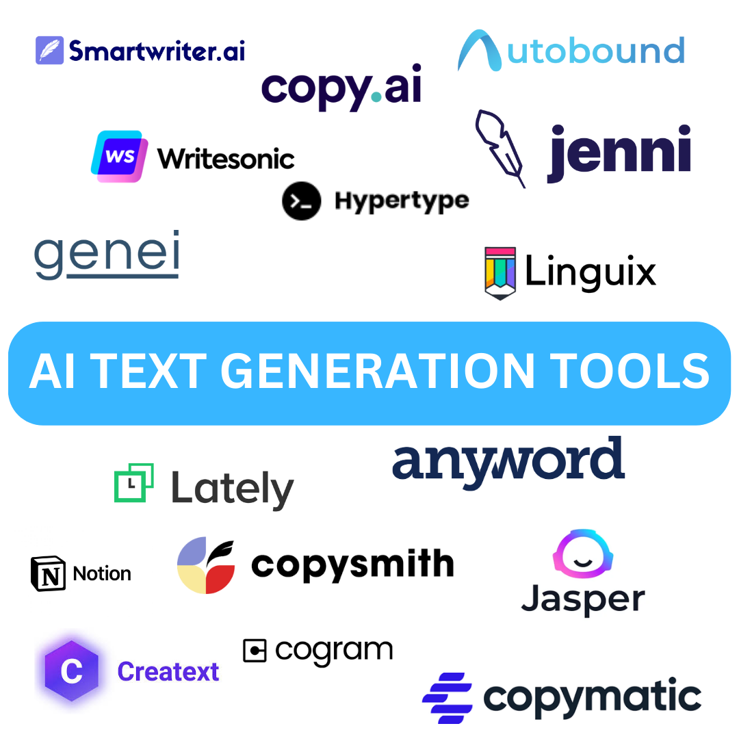
Core Techniques
Variational Autoencoders (VAEs): Learn a compressed data representation to generate new data points, useful for high-dimensional data like images.
Generative Adversarial Networks (GANs): A generator creates data, and a discriminator distinguishes real from generated data. This competition leads to realistic outputs.
Diffusion Models: Add noise to data, then learn to reverse this process to generate data from noise; excellent for image generation.
Autoregressive Models: Generate data sequentially, predicting the next element based on previous ones (e.g., large language models).

Slide 4
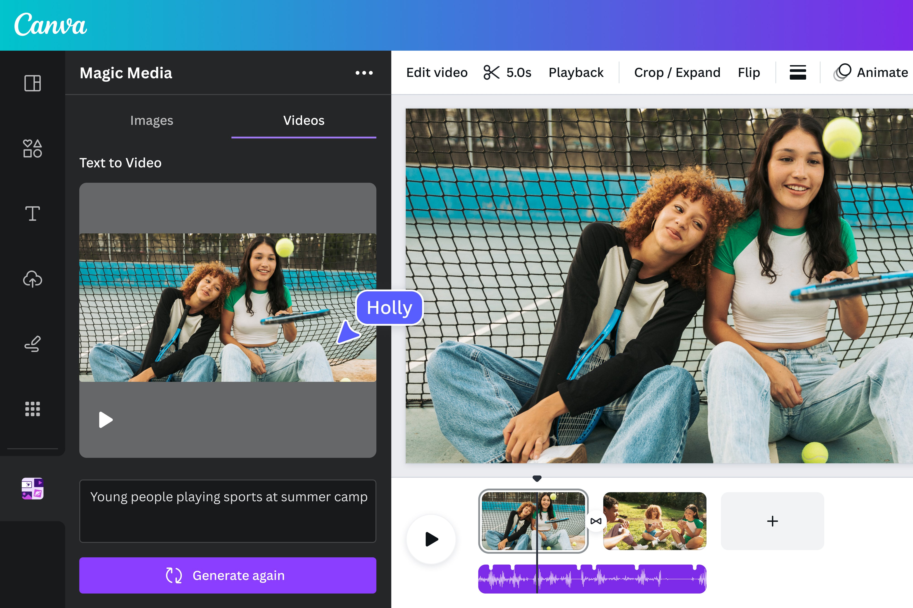
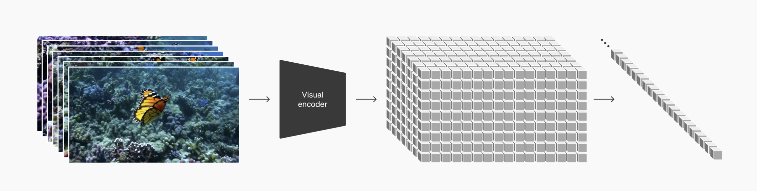
Applications of Generative AI
Art & Design: Unique artwork, product design, realistic textures.
Drug Discovery: Designing molecules with specific properties.
Content Creation: Text, images, videos for marketing, entertainment, education.
Data Augmentation: Increasing dataset size for training ML models.
Robotics: Generating control policies for complex tasks.

Slide 5
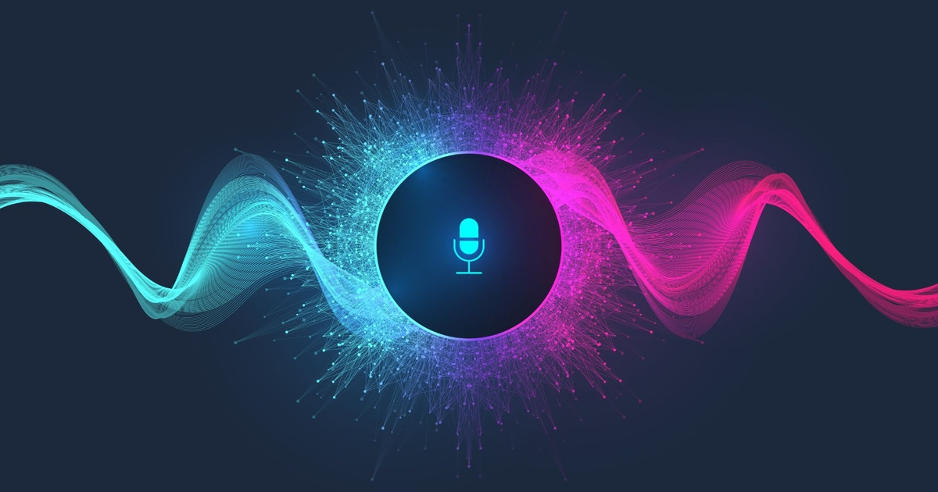
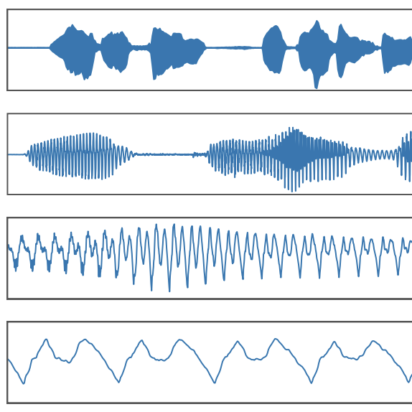
Limitations & Ethical Concerns
Bias Amplification: Perpetuates biases in training data, leading to unfair outcomes.
Computational Cost: Training is resource-intensive.
Controllability: Difficult to fully control the output.
Misinformation & Deepfakes: Potential for creating realistic but fake content.

Slide 6
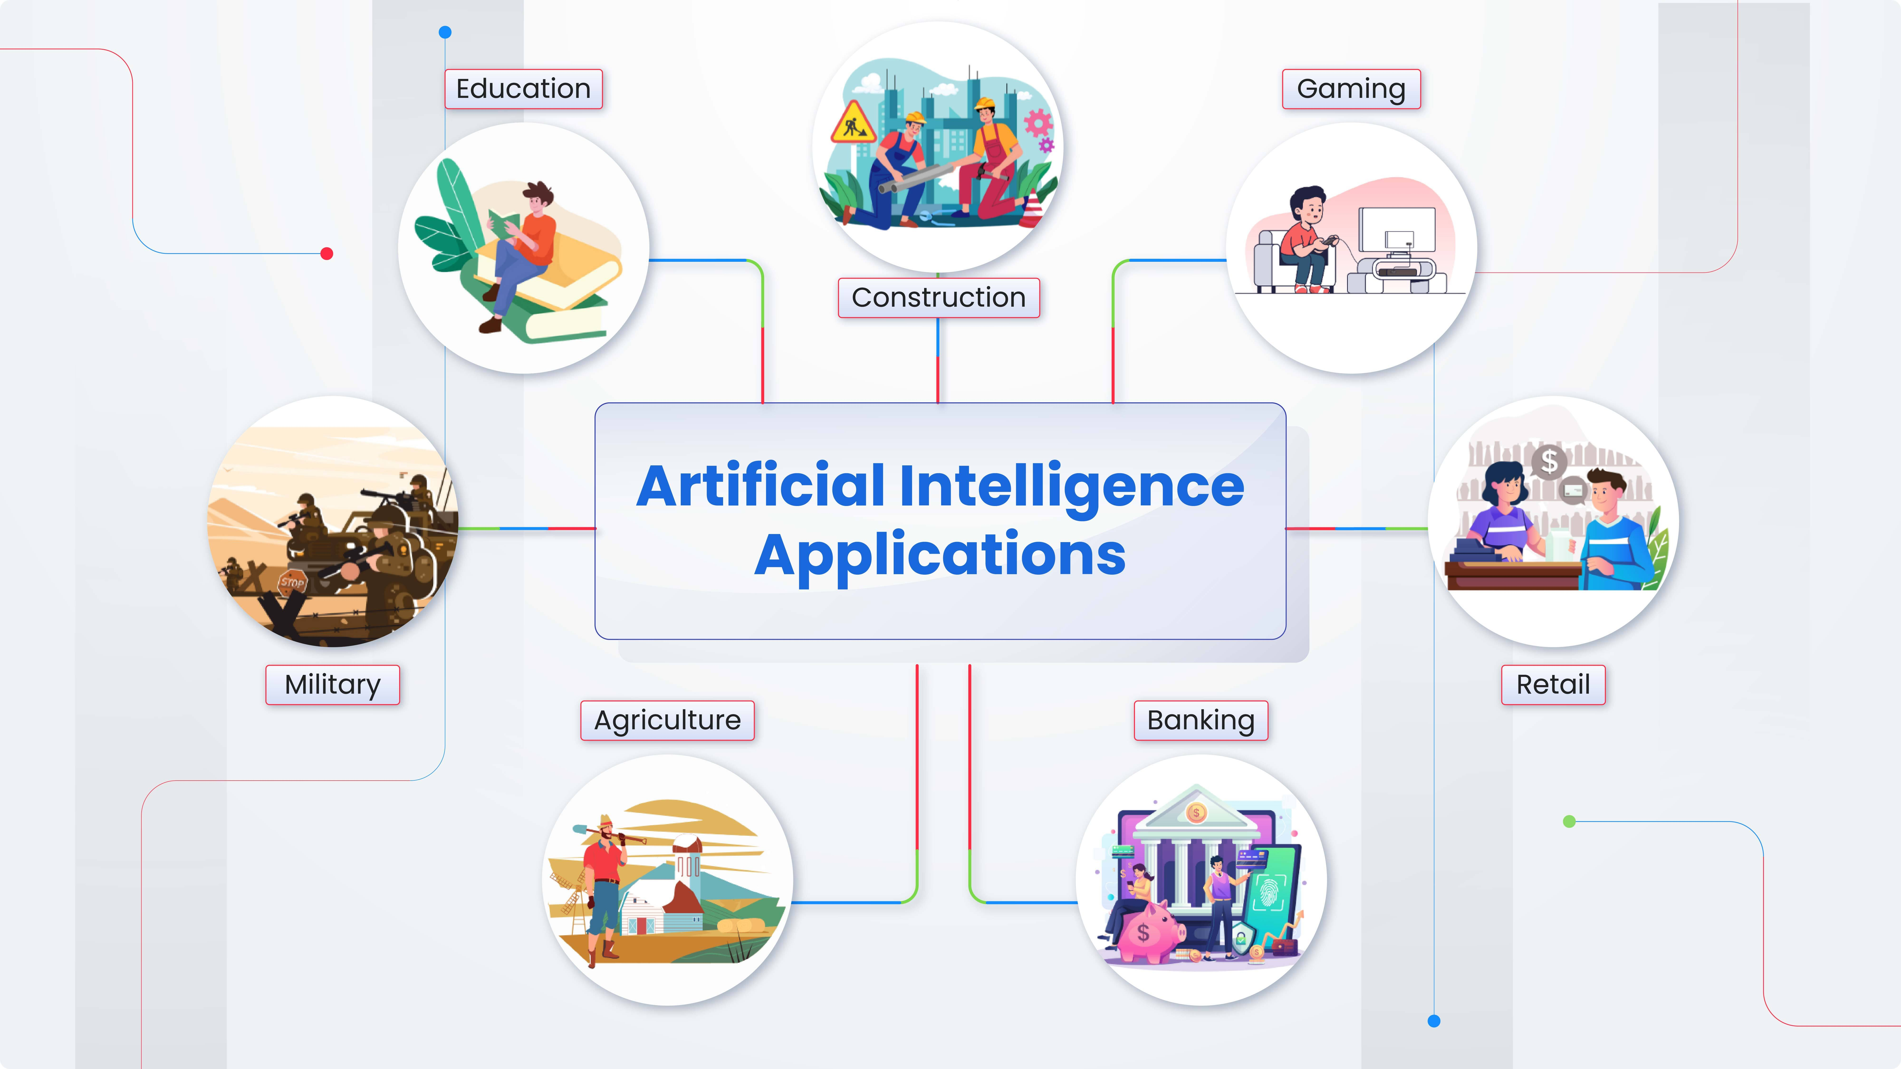
Types of Generative Models
Variational Autoencoders (VAEs): Encode data into a lower-dimensional latent space and decode it back, generating new samples.
Generative Adversarial Networks (GANs): A generator and discriminator compete to create realistic data.
Autoregressive Models: Generate data sequentially, predicting the next element.
Diffusion Models: Add and remove noise to generate data.
Flow-based Models: Learn a bijective mapping between a simple and the data distribution for efficient sampling.

Slide 7
Understanding Latent Space
A lower-dimensional representation capturing essential data features. Manipulating this space controls generated samples (e.g., interpolation creates new samples).

Slide 8
Training & Evaluation
Training involves complex optimization (minimax for GANs, variational lower bound for VAEs). Evaluation uses metrics like Inception Score (IS), Fréchet Inception Distance (FID), and human evaluation to assess quality and diversity.

Slide 9
Applications of Generative Models
Image generation: Realistic images of faces, objects, scenes.
Text generation: Human-quality text (stories, articles, code).
Audio generation: Realistic music and speech.
Drug discovery: Novel molecules.
Anomaly detection: Identifying unusual patterns.
Data augmentation: Generating synthetic data.

Slide 10
Definition & Core Concepts
AI text generation uses algorithms to create coherent, contextually relevant text. Key concepts: language modeling (predicting word sequence probability) and text generation models (using this probability to produce new text). Models use techniques like RNNs, transformers, and Markov chains.

Slide 11
Approaches to AI Text Generation
Template-based: Simple, limited creativity.
Rule-based: More complex, struggles with nuanced language.
Statistical (n-gram): Predicts next word based on preceding 'n' words; lacks long-range context.
RNNs: Process sequential data; can struggle with long sequences.
LSTMs: Address vanishing gradient problem in RNNs.
Transformers: Utilize attention mechanisms for superior context understanding.

Slide 12
Deep Learning Models
Deep learning models, particularly transformers (GPT-3, LaMDA), are at the forefront. Trained on massive datasets, they learn complex patterns to generate coherent text.

Slide 13
Applications of AI Text Generation
Chatbots: Engaging conversations.
Content creation: Marketing copy, articles.
Machine translation: Translating text.
Code generation: Generating code snippets.
Creative writing: Assisting writers.
Summarization: Condensing large amounts of text.

Slide 14
Ethical Considerations
Bias & Fairness: Models trained on biased data perpetuate stereotypes.
Misinformation: Potential for generating realistic fake content.
Copyright & Ownership: Ownership of AI-generated text is unclear.
Transparency & Explainability: Understanding model outputs is crucial.

Slide 15
Fundamentals
Generative AI models learn the distribution of real-world image/video data to generate new samples. Architectures include GANs, VAEs, Diffusion Models, and Autoregressive Models.

Slide 16
GANs
A generator creates synthetic images, and a discriminator distinguishes between real and generated images. Adversarial training results in realistic images (e.g., StyleGAN, DeepFake).

Slide 17
VAEs
Learn a compressed representation (latent space) to generate new data by sampling and decoding. Useful for controlled generation but might not produce the highest-quality images.

Slide 18
Diffusion Models
Add noise to an image until pure noise, then reverse the process to reconstruct an image from noise. Produces high-quality images with fine-grained control (e.g., Stable Diffusion, DALL-E 2).

Slide 19
Autoregressive Models
Generate images pixel by pixel or patch by patch; good for sharp images but computationally expensive.

Slide 20
Applications
Creative industry: Art generation, product design, special effects.
Healthcare: Medical image synthesis.
Gaming: Game environments, character design.
Autonomous vehicles & robots: Realistic simulations.

Slide 21
Ethical Considerations
Potential for misuse in creating deepfakes and spreading misinformation. Detection of synthetic media and responsible use are crucial.

Slide 22
Introduction
Audio generation uses algorithms to create new audio waveforms (from simple sounds to complex music). Generative AI learns patterns from existing data to generate new, similar audio using deep learning models (RNNs, transformers).

Slide 23
Deep Learning Models
RNNs (LSTMs, GRUs): Process sequential audio data.
WaveNet: Generates raw audio waveforms for high-quality audio.
Transformer Networks: Process long-range dependencies for complex audio sequences.
Diffusion Models: Add and remove noise to generate audio.

Slide 24
Data Representation & Preprocessing
Convert raw audio waveforms into numerical representations (spectrograms, mel-spectrograms) for model processing. Data augmentation techniques improve model performance.

Slide 25
Training & Evaluation
Training involves optimizing model parameters using loss functions (MSE, perceptual loss functions). Evaluation uses subjective listening tests and objective measures (FID, IS).

Slide 26
Applications
Music generation: Creating new musical pieces.
Speech synthesis: Generating realistic speech.
Sound effects design: Generating unique sound effects.
Audio enhancement: Improving audio quality.
Personalized audio experiences: Generating customized audio.

Slide 27
Challenges & Future Directions
Generating long, coherent sequences, controlling style/content, ensuring high-quality and diverse audio are ongoing challenges.

Slide 28
Bias and Discrimination
Generative AI models can amplify existing societal biases, leading to discriminatory outputs. Mitigation requires careful data curation, algorithmic adjustments, and monitoring.

Slide 29
Misinformation and Malicious Use
Generative AI can create realistic fake content (deepfakes, fake news). Combating this requires detection methods, media literacy, and regulations.

Slide 30
Intellectual Property and Copyright
The legal landscape surrounding AI-generated content ownership is unclear. Clearer legal frameworks are needed.

Slide 31
Job Displacement and Economic Impact
Automation potential raises concerns about job displacement. Reskilling and upskilling initiatives are crucial.

Slide 32
Transparency and Explainability
Understanding model decision-making processes is essential for building trust and accountability.

Slide 33
Environmental Impact
Training large models consumes significant energy. More energy-efficient methods and sustainable infrastructure are needed.

Slide 34
Responsibility and Accountability
Determining responsibility for harmful outputs requires clear lines of accountability for developers, users, and policymakers.

Slide 35
Text Generation
Applications include chatbots, automated content creation, and writer assistance. Large language models are key (e.g., generating different product descriptions).

Slide 36
Image Generation
Applications include art and design, gaming, and medical imaging (e.g., generating building designs based on parameters).

Slide 37
Music Generation
AI composes music for videos, games, and personalized music experiences.

Slide 38
Code Generation
AI assists programmers by generating code snippets or entire programs from natural language descriptions.

Slide 39
Drug Discovery and Materials Science
Generative models design new molecules and materials with specific properties (e.g., predicting molecule properties based on structure).

Slide 40
Challenges and Ethical Considerations
Potential biases, misuse risks, and copyright issues require careful consideration and responsible development.

